Slide 1


Slide 2
Data Analysis & Power BI

Slide 3


Slide 4


Slide 5
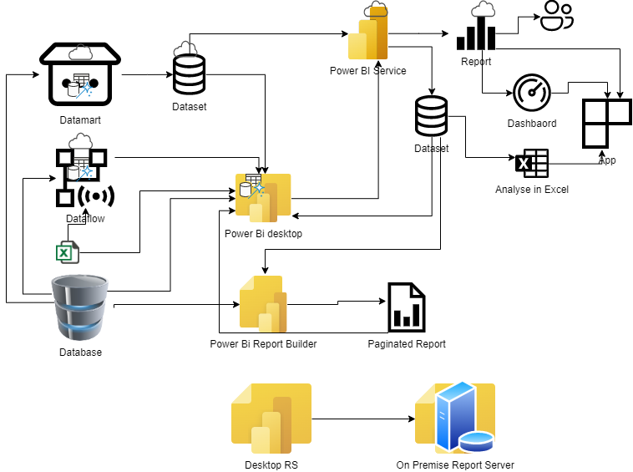
Power BI Ecosystem

Slide 6
Power Platform
The ‘Power Platform’ is a collective term for four key products: Power Apps, Power Automate, Power BI and Power Virtual Agents

Slide 7
Power App
Power Apps provides a rapid low code development environment for building custom apps for business needs. It has services, connectors, and a scalable data service and app platform (Microsoft Dataverse) to allow simple integration and interaction with existing data. Power Apps enables the creation of web and mobile applications that run on all devices.

Slide 8
Power Automate
Power Automate lets users create automated workflows between applications and services. It helps automate repetitive business processes such as communication, data collections, and decision approvals.

Slide 9
Power Virtual Agent
Power Virtual Agents enables anyone to create powerful chatbots using a guided, no-code graphical interface, without the need for data scientists or developers. It minimizes the IT effort required to deploy and maintain a custom solution by empowering subject matter experts to build and maintain their own conversational solutions..

Slide 10
Power BI
Power BI (Business Intelligence) is a business analytics service that delivers insights for analyzing data. It can share those insights through data visualizations which make up reports and dashboards to enable fast, informed decisions. Power BI scales across an organization, and it has built-in governance and security allowing businesses to focus on using data more than managing it.

Slide 11
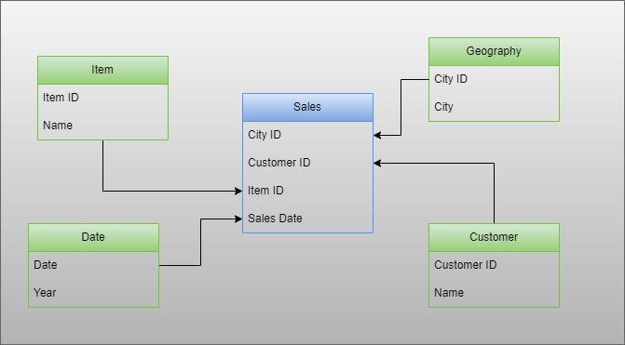

Slide 12
Configure Data
Rename Table
Rename Column
Table Tools
Column Tools
Property Pane
Model View
Create Relationship

Slide 13
Create Calculated Columns and measures
Calculated Columns
Gross Amount = [Qty]*Sales[Price]
Discount Amount = [Gross Amount]*[Discount Percent]/100.0
COGS Amount= [QTY] *[COST]
Measures
Gross = Sum(Sales[Gross Amount])
Discount = sum(Sales[Discount Amount])
Net = [Gross] -[Discount]
COGS = sum(Sales[COGS Amount])
Margin = [Net] -[COGS]
Discount % = DIVIDE([Discount],[Gross])
Margin % = divide([Margin],[Net])
Difference

Slide 14
Functions
Calculate
Filter
Sum
Min
Max
Count
DistinctCount

Slide 15
Create Visuals
Table, Matrix
Filters/Slicers
Bar, Stacked, Line
Pie, Donut
Tree Map, Scatter
Card, Multi Row Card
MAPs
AI Visuals

Slide 16
Expression Functions
SUMX
MINX
MAXX
COUNTX

Slide 17
DAX
ALL, AllSelected
Removefilters
Allexcept
Calculate With and Without Filter

Slide 18
EARLIER
EARLIER

Slide 19
Create Date Table- Standard
Calendar, Calendarauto
addcolumns
EOMONTH
Weekday
Weekno
Year, Quarter, Month
Startof*
Endof*

Slide 20
Conditional
If
Switch

Slide 21
Text Function
Search
Find
containsstring
containsstringexact
Left
Mid
Right
CONCATENATEX

Slide 22
More DAX
RANKX,TOPN
Firstnonblankvalue
Lastnonblankvalue
Distinct count using values/summarize
Isinscope
hasonevalue

Slide 23
DAX – New Functions
Offset
Window
Index
Rank
RowNumber

Slide 24
Table Function
CalculateTable
Summarize,Groupby
Summarizecolumns
Distinct
Except
Generateseries
Generate,crossjoin

Slide 25
DAX – Time Intelligence
Dates* function
Total* functions
Previous functions
Week on Week
Half year

Slide 26
Power BI Features
Conditional formatting
Interactions
Numeric Parameter
Bookmarks
Field Parameters
Calculation Groups
Drill Through
Tooltip Page

Slide 27
Data Transformation
Pivot Data
Unpivot Data
Transform Data
Fill up , Fill Down
Append
Merge
Split Column
Calculated Columns

Slide 28
Publish
Publish Data
Dataset/Visual File
Dataflow
Dashboard
Create report on Service
Create report using dataset

Slide 29
Six key points to remember
1. Use Date Table (Join with Fact Date) 2. The date table is marked as a date table 3. Use columns from the date table 4. The date does not have a timestamp 5. The date table has all dates 6. Avoid bidirectional join with date table

Slide 30
Understand till Date
Assume my Date is 15-Sep-2024.
MTD – 1-Sep-2024 to 15-Sep-2024
QTD – 1-Jul-2024 to 15-Sep-2024
YTD – 1-Jan-2024 to 15-Sep-2024
If My Year Start from 1st Apr 2024
MTD – 1-Sep-2024 to 15-Sep-2024
QTD – 1-Jul-2024 to 15-Sep-2024
YTD – 1-Apr-2024 to 15-Sep-2024 (FYTD)

Slide 31
ALL and Allselected
Net All = CALCULATE([Net], ALL())
Net All = CALCULATE([Net], ALLSELECTED())
ALL disregard filters on a specific column or table to retrieve unfiltered data for calculations.
ALLSELECTED preserves user selections or filters in the specified column while removing filters from other columns, allowing selective adjustments.
In short, All ignores all the filter context including filter and visual filter row context of given column/table. On the other hand, allselected ignore only the and visual filter row context.

Slide 32
What is the difference between filtering data in CALCULATE with and without FILTER Expression
Filter Expression without filter function
CALCULATE([Net], 'Item'[Brand] = "Brand 1")
Filter Function
CALCULATE([Net], FILTER('Item', 'Item'[Brand] = "Brand 1"))
CALCULATE function without a FILTER function, you directly apply filters to specific columns within the calculation. This modifies the filter context and affects how the expression is evaluated. CALCULATE without a FILTER expression applies filters directly to columns, altering the filter context and impacting calculations.
Using the FILTER function within the CALCULATE function allows you to create a filtered table based on specific conditions. This offers a more flexible approach to defining the filter context and customizing how the calculation interacts with the data. CALCULATE with a FILTER expression constructs a custom filter context by creating a filtered table based on specified criteria and returns values based on that.

Slide 33
DAX
Data Analysis Expressions (DAX) is a formula expression language used in Analysis Services, Power BI, and Power Pivot in Excel. DAX formulas include functions, operators, and values to perform advanced calculations and queries on data in related tables and columns in tabular data models.
Source: Microsoft Learn - https://learn.microsoft.com/en-us/dax/dax-overview

Slide 34
DAX Calculations
DAX formulas are used in measures, calculated columns, calculated tables, Visual calculations and row-level security.
Source: Microsoft Learn - https://learn.microsoft.com/en-us/dax/dax-overview

Slide 35
DAX Measures
Measures are dynamic calculation formulas where the results change depending on context. Measures are used in reporting that support combining and filtering model data by using multiple attributes such as a Power BI report or Excel PivotTable or PivotChart. Measures are created by using the DAX formula bar in the model designer.
Source: Microsoft Learn - https://learn.microsoft.com/en-us/dax/dax-overview

Slide 36
DAX Calculated columns
A calculated column is a column that you add to an existing table (in the model designer) and then create a DAX formula that defines the column's values. When a calculated column contains a valid DAX formula, values are calculated for each row as soon as the formula is entered. Values are then stored in the in-memory data model.
Source: Microsoft Learn - https://learn.microsoft.com/en-us/dax/dax-overview

Slide 37
DAX Calculated tables
A calculated table is a computed object, based on a formula expression, derived from all or part of other tables in the same model. Instead of querying and loading values into your new table's columns from a data source, a DAX formula defines the table's values.
Calculated tables support relationships with other tables.
Calculated tables are re-calculated if any of the tables it pulls data from are refreshed or updated.
Source: Microsoft Learn - https://learn.microsoft.com/en-us/dax/dax-overview

Slide 38
DAX Visual Calculation
Visual calculation has been recently added to Power BI. A visual calculation is a DAX calculation that's defined and executed directly on a visual. Visual calculations make it easier to create calculations that were previously hard to create, leading to simpler DAX, easier maintenance, and better performance.
Source: Microsoft Learn - https://learn.microsoft.com/en-us/power-bi/transform-model/desktop-visual-calculations-overview

Slide 39
DAX Queries
DAX queries can be created and run in Dax Query view of Power BI Desktop and open-source tools like DAX Studio (daxstudio.org). Unlike DAX calculation formulas, which can only be created in tabular data models, DAX queries can also be run against Analysis Services Multidimensional models. DAX queries are often easier to write and more efficient than Multidimensional Data Expressions (MDX) queries.
To Run DAX Queries, you need use EVALUATE. One should make sure that query should return a table.
You can also use order by in DAX queries, which we usually do not use in visual explicitly
Source: Microsoft Learn - https://learn.microsoft.com/en-us/dax/dax-overview

Slide 40
DAX Data types
You can import data into a model from many different data sources that might support different data types. When you import data into a model, the data is converted to one of the tabular model data types.
Whole Number
Decimal Number
Boolean
Text
Date
Date/time: Valid dates are all dates after March 1, 1900.
Currency
N/A: Blank- A blank is a data type in DAX that represents and replaces SQL nulls. You can create a blank by using the BLANK function, and test for blanks by using the logical function, ISBLANK.
Source: Microsoft Learn - https://learn.microsoft.com/en-us/dax/dax-overview

Slide 41
DAX Variables
You can create variables within an expression by using VAR. VAR is technically not a function, it's a keyword to store the result of an expression as a named variable. That variable can then be passed as an argument to other measure expressions. For example:
Measure =
Var _max = max(‘Date’[Date])
Return
Calculate(Sum(Sales[Gross Amount]), filter(all(‘Date’), ‘Date’[Date] = _max)
Make sure you use return
Source: Microsoft Learn - https://learn.microsoft.com/en-us/dax/dax-overview

Slide 42


Slide 43
Context
Context is an important concept to understand when creating DAX formulas. Context is what enables you to perform dynamic analysis, as the results of a formula change to reflect the current row or cell selection and also any related data. Understanding context and using context effectively are critical for building high-performing, dynamic analyses, and for troubleshooting problems in formulas.
Formulas in tabular models can be evaluated in a different context, depending on other design elements:
Filters applied in a PivotTable or report
Filters defined within a formula
Relationships specified by using special functions within a formula
There are different types of context: row context, query context, and filter context.
Source: Microsoft Learn - https://learn.microsoft.com/en-us/dax/dax-overview

Slide 44
Row context
Row context can be thought of as "the current row". If you create a formula in a calculated column, the row context for that formula includes the values from all columns in the current row. If the table is related to another table, the content also includes all the values from the other table that are related to the current row.
For example, suppose you create a calculated column, = [Qty1] + [Qty2], that adds together values from two columns [Qty1] + [Qty2], from the same table. This formula automatically gets only the values from the current row in the specified columns.
Row context also follows any relationships that have been defined between tables, including relationships defined within a calculated column by using DAX formulas, to determine which rows in related tables are associated with the current row.
RELATED function can fetch a related table, based on the relation.
Source: Microsoft Learn - https://learn.microsoft.com/en-us/dax/dax-overview

Slide 45
Multiple row context
DAX includes functions that iterate calculations over a table. These functions can have multiple current rows, each with its own row context. In essence, these functions let you create formulas that perform operations recursively over an inner and outer loop.
For example, suppose your model contains a Products table and a Sales table. Users might want to go through the entire sales table, which is full of transactions involving multiple products, and find the largest quantity ordered for each product in any one transaction.
With DAX you can build a single formula that returns the correct value, and the results are automatically updated any time a user adds data to the tables.
Minx(FILTER(Sales,[Customer ID] = EARLIER([Customer ID])),Sales[Sales Date])
To summarize, the EARLIER function stores the row context from the operation that preceded the current operation.
Source: Microsoft Learn - https://learn.microsoft.com/en-us/dax/dax-overview

Slide 46
Query context
Query context refers to the subset of data that is implicitly retrieved for a formula. For example, when a user places a measure or field into a report, the engine examines row and column headers, slicers, and report filters to determine the context. The necessary queries are then run against model data to get the correct subset of data, make the calculations defined by the formula, and then populate values in the report.
Because context changes depending on where you place the formula, the results of the formula can also change. For example, suppose you create a formula that sums the values in the Gross Amount column of the Sales table: = SUM('Sales’[Gross Amount]). If you use this formula in a calculated column within the Sales table, the results for the formula will be the same for the entire table, because the query context for the formula is always the entire data set of the Sales table. Results will have gross Amount for all regions, all products, all years, and so on.
However, users typically don't want to see the same result hundreds of times, but instead want to get the profit for a particular year, a particular country, a particular product, or some combination of these, and then get a grand total.
In a report, context is changed by filtering, adding or removing fields, and using slicers. For each change, the query context in which the measure is evaluated. Therefore, the same formula, used in a measure, is evaluated in a different query context for each cell.
Source: Microsoft Learn - https://learn.microsoft.com/en-us/dax/dax-overview

Slide 47
Filter context
Filter context is the set of values allowed in each column, or in the values retrieved from a related table. Filters can be applied to the column in the designer, or in the presentation layer (reports and PivotTables). Filters can also be defined explicitly by filter expressions within the formula.
Filter context is added when you specify filter constraints on the set of values allowed in a column or table, by using arguments to a formula. Filter context applies on top of other contexts, such as row context or query context.
In tabular models, there are many ways to create filter context. Within the context of clients that can consume the model, such as Power BI reports, users can create filters on the fly by adding slicers or report filters on the row and column headings. You can also specify filter expressions directly within the formula, to specify related values, to filter tables that are used as inputs, or to dynamically get context for the values that are used in calculations. You can also completely clear or selectively clear the filters on particular columns. This is very useful when creating formulas that calculate grand totals.
Source: Microsoft Learn - https://learn.microsoft.com/en-us/dax/dax-overview

Slide 48
DAX
Data Analysis Expressions (DAX) is a formula expression language used in Analysis Services, Power BI, and Power Pivot in Excel. DAX formulas include functions, operators, and values to perform advanced calculations and queries on data in related tables and columns in tabular data models.
Source: Microsoft Learn - https://learn.microsoft.com/en-us/dax/dax-overview

Slide 49



Slide 50
Row Context
Physical Row of Table
In a calculated Column
iterator like FILTER, SUMX, AVERAGEX, ADDCOLUMNS
Applies to one row at time
Filter Context
Slicer, Filter
Visual, DAX
Applies to Set of row

Slide 51
Filter Context Usage
Slicer, Filter – Used as Filter of Filter context
Visual – Used as Context, Filter context, Visual row filter context, row filter context
DAX- Used filter for formula filter context or context

Slide 52
What is the difference between filtering data in CALCULATE with and without FILTER Expression
Filter Expression without filter function
CALCULATE([Net], 'Item'[Brand] = "Brand 1")
Filter Function
CALCULATE([Net], FILTER('Item', 'Item'[Brand] = "Brand 1"))
CALCULATE function without a FILTER function, you directly apply filters to specific columns within the calculation. This modifies the filter context and affects how the expression is evaluated. CALCULATE without a FILTER expression applies filters directly to columns, altering the filter context and impacting calculations.
Using the FILTER function within the CALCULATE function allows you to create a filtered table based on specific conditions. This offers a more flexible approach to defining the filter context and customizing how the calculation interacts with the data. CALCULATE with a FILTER expression constructs a custom filter context by creating a filtered table based on specified criteria and returns values based on that.

Slide 53
Similar to SQL Window Functions
Dec - 2022
Offset
Window
Index
April -2023
Rank
RowNumber

Slide 54
Key Highlights
These DAX functions are similar to SQL window functions, performing calculations across related table rows based on the DAX evaluation context. Unlike SQL window functions, these DAX functions do not return a single value but a set of rows, which can be used with functions like CALCULATE or SUMX to compute a value. These functions execute in the DAX engine rather than being pushed to the data source, offering improved performance, particularly when sorting by non-continuous columns.

Slide 55
Key Highlights
OrderBy
Partitionby
Axis
Reset

Slide 56


Slide 57
What is Power Query?
Power Query is a data transformation and data preparation engine. Power Query comes with a graphical interface for getting data from sources and a Power Query Editor for applying transformations. Because the engine is available in many products and services, the destination where the data will be stored depends on where Power Query was used. Using Power Query, you can perform the extract, transform, and load (ETL) processing of data.
Source: Microsoft Learn - https://learn.microsoft.com/en-us/dax/dax-overview

Slide 58
Power Query Experience
The Power Query user experience is provided through the Power Query Editor user interface. The goal of this interface is to help you apply the transformations you need simply by interacting with a user-friendly set of ribbons, menus, buttons, and other interactive components.
Power Query Online— Found in integrations such as Power BI dataflows, Microsoft Fabric Dataflow Gen 2, Microsoft Power Platform dataflows, Azure Data Factory wrangling dataflows, and many more that provide the experience through an online webpage.
Power Query for Desktop—Found in integrations such as Power Query for Excel and Power BI Desktop.
Source: Microsoft Learn - https://learn.microsoft.com/en-us/dax/dax-overview

Slide 59
Power Query M formula language
The Power Query engine uses a scripting language behind the scenes for all Power Query transformations: the Power Query M formula language, also known as M.
The M language is the data transformation language of Power Query. Anything that happens in the query is ultimately written in M. If you want to do advanced transformations using the Power Query engine, you can use the Advanced Editor to access the script of the query and modify it as you want. If you find that the user interface functions and transformations won't perform the exact changes you need, use the Advanced Editor and the M language to fine-tune your functions and transformations.
Source: Microsoft Learn - https://learn.microsoft.com/en-us/dax/dax-overview

Slide 60
What is M
M is a case-sensitive language. Used in Power Query in case of Power BI
To create an M query in the Query Editor, you follow this basic process:
Create a series of query formula steps that start with the let statement. Each step is defined by a step variable name. An M variable can include spaces by using the # character as #"Step Name". A formula step can be a custom formula. Please note that the Power Query Formula Language is case sensitive.
Each query formula step builds upon a previous step by referring to a step by its variable name.
Output a query formula step using the in statement. Generally, the last query step is used as the in final data set result.
Source: Microsoft Learn - https://learn.microsoft.com/en-us/dax/dax-overview

Slide 61
Example Code
let
Variablename = expression,
#"Variable name" = expression2
in
Variablename
Source: Microsoft Learn - https://learn.microsoft.com/en-us/dax/dax-overview

Slide 62
Primitive value
A primitive value is single-part value, such as a number, logical, text, or null. A null value can be used to indicate the absence of any data
Type Example value
Binary 00 00 00 02 // number of points (2)
Date 5/23/2015
DateTime 5/23/2015 12:00:00 AM
DateTimeZone 5/23/2015 12:00:00 AM -08:00
Duration 15:35:00
Logical true and false
Null null
Number 0, 1, -1, 1.5, and 2.3e-5
Text "abc"
Time 12:34:12 PM
Source: Microsoft Learn - https://learn.microsoft.com/en-us/dax/dax-overview

Slide 63
Function
A Function is a value that, when invoked with arguments, produces a new value. Functions are written by listing the function’s parameters in parentheses, followed by the goes-to symbol =>, followed by the expression defining the function. For example, to create a function called “MyFunction” that has two parameters and performs a calculation on parameter1 and parameter2:
let
MyFunction = (parameter1, parameter2) => (parameter1 + parameter2) / 2
in
MyFunction
Source: Microsoft Learn - https://learn.microsoft.com/en-us/dax/dax-overview

Slide 64
Structured data values
List
Record
Table
Additional structured data examples
Source: Microsoft Learn - https://learn.microsoft.com/en-us/dax/dax-overview

